Slide 2
Example
Given the bit pattern 01100, encode this data using ASK, BFSK, and BPSK.

Slide 3
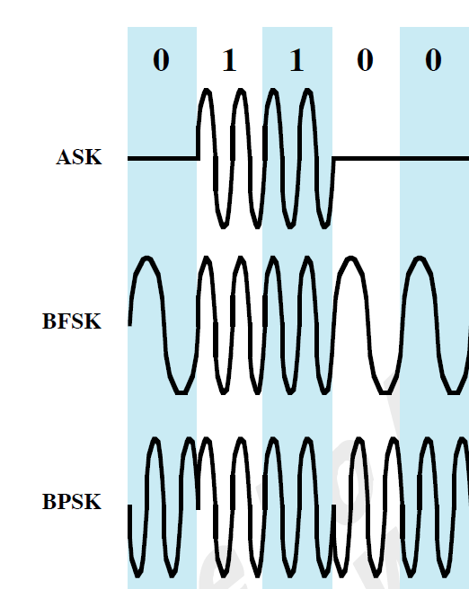

Slide 4
Example
An NRZ-L signal is passed through a filter with r=0.5 and then modulated onto a carrier. The data rate is 2400 bps. Evaluate the bandwidth for ASK and FSK. For FSK assume that the two frequencies used are 50 kHz and 55 kHz.

Slide 5
For ASK, BT = (1 + r)R = (1.5)2400 = 3600 Hz
For FSK,
BT = 2 Δ F + (1 + r)R
= 2(2.5 x 10*10*10) + (1.5)2400 = 8600 Hz

Slide 6
Example
Assume that a telephone line channel is equalized to allow bandpass data transmission over a frequency range of 600 to 3000 Hz. The available bandwidth is 2400 Hz. For r=1 evaluate the required bandwidth for 2400 bps QPSK and 4800-bps, eight level multilevel signaling. Is the bandwidth adequate?

Slide 7
For multilevel signaling BT = [(1 + r)/log2M]R
For 2400 bps QPSK,
log2M = log24 = 2
BT = (2/2)2400 = 2400 Hz, which just fits the available bandwidth
For 8-level 4800 bps signaling,
log2M = log28 = 3
BT = (2/3)(4800) = 3200 Hz, which exceeds the available bandwidth

Slide 8
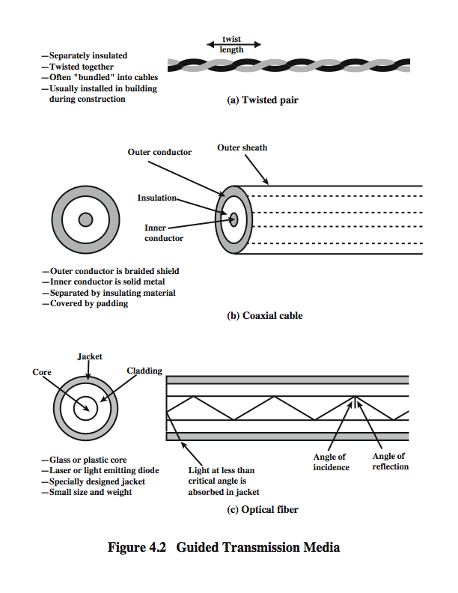
Coaxial Cable
Notes:
Coaxial cable, like twisted pair, consists of two conductors, but is constructed differently to permit it to operate over a wider range of frequencies. It consists of a hollow outer cylindrical conductor that surrounds a single inner wire conductor (Stallings DCC8e Figure 4.2b). The inner conductor is held in place by either regularly spaced insulating rings or a solid dielectric material. The outer conductor is covered with a jacket or shield. A single coaxial cable has a diameter of from 1 to 2.5 cm. Coaxial cable can be used over longer distances and support more stations on a shared line than twisted pair.
Coaxial cable is a versatile transmission medium, used in a wide variety of applications, including:
• Television distribution - aerial to TV & CATV systems
• Long-distance telephone transmission - traditionally used for inter-exchange links, now being replaced by optical fiber/microwave/satellite
• Short-run computer system links
• Local area networks

Slide 9
Coaxial Cable - Transmission Characteristics
superior frequency characteristics to TP
performance limited by attenuation & noise
analog signals
amplifiers every few km
closer if higher frequency
up to 500MHz
digital signals
repeater every 1km
closer for higher data rates
Notes:
Coaxial cable is used to transmit both analog and digital signals. It has frequency characteristics that are superior to those of twisted pair and can hence be used effectively at higher frequencies and data rates. Because of its shielded, concentric construction, coaxial cable is much less susceptible to interference and crosstalk than twisted pair. The principal constraints on performance are attenuation, thermal noise, and intermodulation noise. The latter is present only when several channels (FDM) or frequency bands are in use on the cable.
For long-distance transmission of analog signals, amplifiers are needed every few kilometers, with closer spacing required if higher frequencies are used. The usable spectrum for analog signaling extends to about 500 MHz. For digital signaling, repeaters are needed every kilometer or so, with closer spacing needed for higher data rates.

Slide 11
Optical Fiber
Notes:
An optical fiber is a thin (2 to 125 µm), flexible medium capable of guiding an optical ray. Various glasses and plastics can be used to make optical fibers. An optical fiber cable has a cylindrical shape and consists of three concentric sections: the core, the cladding, and the jacket (Stallings DCC8e Figure 4.2c). The core is the innermost section and consists of one or more very thin strands, or fibers, made of glass or plastic; the core has a diameter in the range of 8 to 50 µm. Each fiber is surrounded by its own cladding, a glass or plastic coating that has optical properties different from those of the core and a diameter of 125 µm. The interface between the core and cladding acts as a reflector to confine light that would otherwise escape the core. The outermost layer, surrounding one or a bundle of cladded fibers, is the jacket. The jacket is composed of plastic and other material layered to protect against moisture, abrasion, crushing, and other environmental dangers.
Optical fiber already enjoys considerable use in long-distance telecommunications, and its use in military applications is growing. The continuing improvements in performance and decline in prices, together with the inherent advantages of optical fiber, have made it increasingly attractive for local area networking. Five basic categories of application have become important for optical fiber: Long-haul trunks, Metropolitan trunks, Rural exchange trunks, Subscriber loops & Local area networks.

Slide 12
Optical Fiber - Benefits
greater capacity
data rates of hundreds of Gbps
smaller size & weight
lower attenuation
electromagnetic isolation
greater repeater spacing
10s of km at least
Notes:
The following characteristics distinguish optical fiber from twisted pair or coaxial cable:
• Greater capacity: The potential bandwidth, and hence data rate, of optical fiber is immense; data rates of hundreds of Gbps over tens of kilometers have been demonstrated. Compare this to the practical maximum of hundreds of Mbps over about 1 km for coaxial cable and just a few Mbps over 1 km or up to 100 Mbps to 10 Gbps over a few tens of meters for twisted pair.
• Smaller size and lighter weight: Optical fibers are considerably thinner than coaxial cable or bundled twisted-pair cable. For cramped conduits in buildings and underground along public rights-of-way, the advantage of small size is considerable. The corresponding reduction in weight reduces structural support requirements.
• Lower attenuation: Attenuation is significantly lower for optical fiber than for coaxial cable or twisted pair, and is constant over a wide range.
• Electromagnetic isolation: Optical fiber systems are not affected by external electromagnetic fields. Thus the system is not vulnerable to interference, impulse noise, or crosstalk. By the same token, fibers do not radiate energy, so there is little interference with other equipment and there is a high degree of security from eavesdropping. In addition, fiber is inherently difficult to tap.
• Greater repeater spacing: Fewer repeaters mean lower cost and fewer sources of error. The performance of optical fiber systems from this point of view has been steadily improving. Repeater spacing in the tens of kilometers for optical fiber is common, and repeater spacings of hundreds of kilometers have been demonstrated.

Slide 13
Optical Fiber - Transmission Characteristics
uses total internal reflection to transmit light
can use several different light sources
Light Emitting Diode (LED)
cheaper, wider operating temp range, lasts longer
Injection Laser Diode (ILD)
more efficient, has greater data rate
Notes:
Optical fiber transmits a signal-encoded beam of light by means of total internal reflection. Total internal reflection can occur in any transparent medium that has a higher index of refraction than the surrounding medium. In effect, the optical fiber acts as a waveguide for frequencies in the range of about 10¹⁴ to 10¹⁵ Hertz; this covers portions of the infrared and visible spectra.
Two different types of light source are used in fiber optic systems: the light-emitting diode (LED) and the injection laser diode (ILD). Both are semiconductor devices that emit a beam of light when a voltage is applied. The LED is less costly, operates over a greater temperature range, and has a longer operational life. The ILD, which operates on the laser principle, is more efficient and can sustain greater data rates.
There is a relationship among the wavelength employed, the type of transmission, and the achievable data rate. Both single mode and multimode can support several different wavelengths of light and can employ laser or LED light sources.

Slide 14
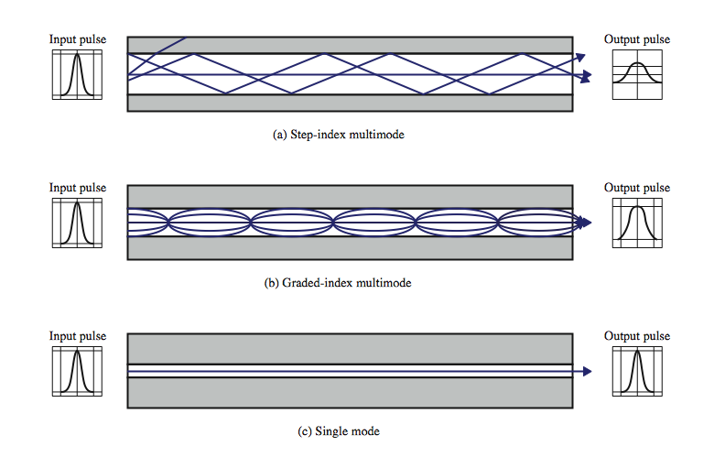
Optical Fiber Transmission Modes
Notes:
Stallings DCC8e Figure 4.4 shows the principle of optical fiber transmission. Light from a source enters the cylindrical glass or plastic core. Rays at shallow angles are reflected and propagated along the fiber; other rays are absorbed by the surrounding material. This form of propagation is called step-index multimode, referring to the variety of angles that will reflect. With multimode transmission, multiple propagation paths exist, each with a different path length and hence time to traverse the fiber. This causes signal elements (light pulses) to spread out in time, which limits the rate at which data can be accurately received. This type of fiber is best suited for transmission over very short distances.
When the fiber core radius is reduced, fewer angles will reflect. By reducing the radius of the core to the order of a wavelength, only a single angle or mode can pass: the axial ray. This single-mode propagation provides superior performance for the following reason. Because there is a single transmission path with single-mode transmission, the distortion found in multimode cannot occur. Single-mode is typically used for long-distance applications, including telephone and cable television.
Finally, by varying the index of refraction of the core, a third type of transmission, known as graded-index multimode, is possible. The higher refractive index (discussed subsequently) at the center makes the light rays moving down the axis advance more slowly than those near the cladding. Rather than zig-zagging off the cladding, light in the core curves helically because of the graded index, reducing its travel distance. The shortened path and higher speed allows light at the periphery to arrive at a receiver at about the same time as the straight rays in the core axis. Graded-index fibers are often used in local area networks.

Slide 15
Comparison of Guided Media
Electrical Cables
Optical Cables
Moderate data rates: 1Gb/s
Maximum distance: 2km (twisted pair); 10km (coaxial)
Cheapest for low data rates
UTP: easy to install, susceptible to interference
STP, Coaxial Cable: rigid, protection against interference
Very high data rates: 100Gb/s
Maximum distance: 40km
Expensive equipment, but cost effective for high data rates, Difficult to install

Slide 16
Wireless transmission 3 general range of frequencies
Microwave frequency 1GHz to 40GHz
Radio frequency 30MHz to 1 GHz
Infrared frequency 3x10¹¹ to 2x10¹² Hz

Slide 17
Antennas
electrical conductor used to radiate or collect electromagnetic energy
transmission antenna
radio frequency energy from transmitter
converted to electromagnetic energy by antenna
radiated into surrounding environment
reception antenna
converted to radio frequency electrical energy
fed to receiver
same antenna is often used for both purposes
Notes:
For unguided media, transmission and reception are achieved by means of an antenna. An antenna can be defined as an electrical conductor or system of conductors used either for radiating electromagnetic energy or for collecting electromagnetic energy.
For transmission of a signal, radio-frequency electrical energy from the transmitter is converted into electromagnetic energy by the antenna and radiated into the surrounding environment.
For reception of a signal, electromagnetic energy impinging on the antenna is converted into radio-frequency electrical energy and fed into the receiver.
In two-way communication, the same antenna can be and often is used for both transmission and reception. This is possible because antenna characteristics are essentially the same whether an antenna is sending or receiving electromagnetic energy.

Slide 18
Radiation Pattern
power radiated in all directions
not same performance in all directions
an isotropic antenna is a (theoretical) point in space
radiates in all directions equally
with a spherical radiation pattern
Notes:
An antenna will radiate power in all directions but, typically, does not perform equally well in all directions. A common way to characterize the performance of an antenna is the radiation pattern, which is a graphical representation of the radiation properties of an antenna as a function of space coordinates.
The simplest pattern is produced by an idealized antenna known as the isotropic antenna. An isotropic antenna is a point in space that radiates power in all directions equally. The actual radiation pattern for the isotropic antenna is a sphere with the antenna at the center.

Slide 19
Direction and propagation of a wave depends on antenna shape
Isotropic antenna: power propagates in all directions equally (spherical pattern, ideal)
Omni-directional antenna: power propagates in all directions on one plane (donut)
Directional antenna: power concentrated in particular direction
Power output in particular direction compared to power produced by isotropic antenna is antenna gain [dB]

Slide 20
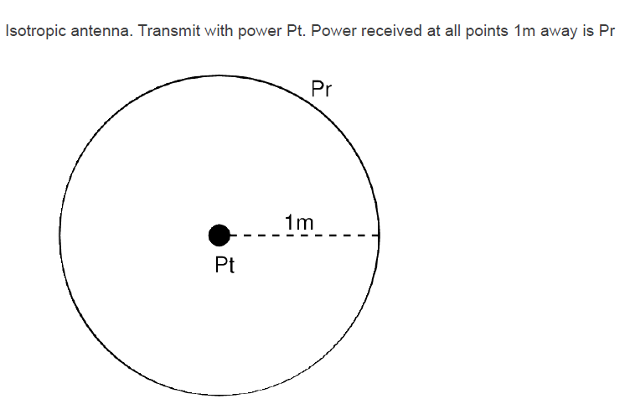
Wireless

Slide 21
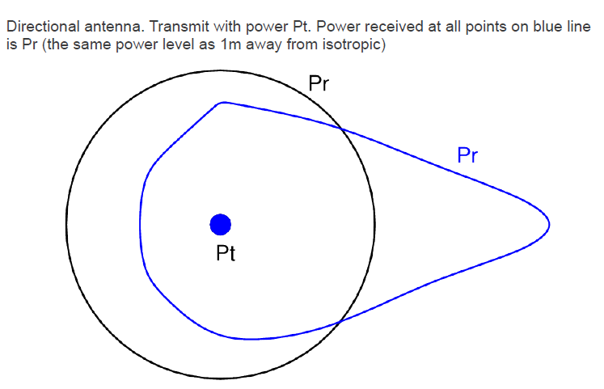

Slide 22
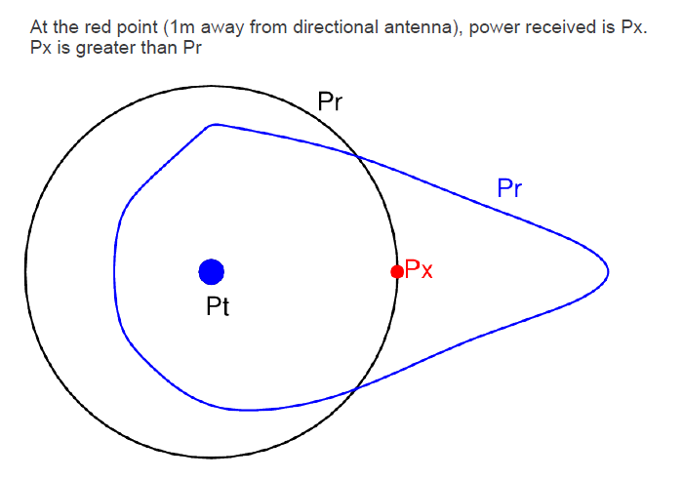

Slide 23
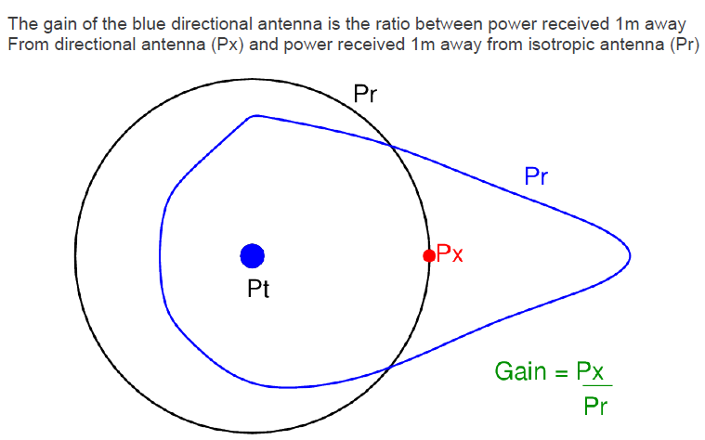

Slide 24
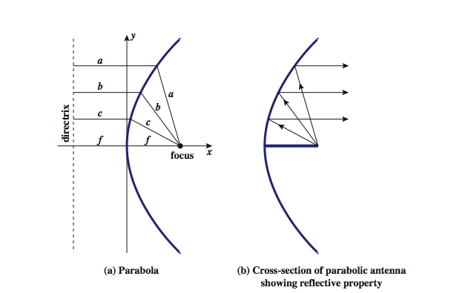
Parabolic Reflective Antenna
Notes:
An important type of antenna is the parabolic reflective antenna, which is used in terrestrial microwave and satellite applications. A parabola is the locus of all points equidistant from a fixed line (the directrix) and a fixed point (the focus) not on the line, as shown in Stallings DCC8e Figure 4.5a above. If a parabola is revolved about its axis, the surface generated is called a paraboloid.
Paraboloid surfaces are used in headlights, optical and radio telescopes, and microwave antennas because: If a source of electromagnetic energy (or sound) is placed at the focus of the paraboloid, and if the paraboloid is a reflecting surface, then the wave will bounce back in lines parallel to the axis of the paraboloid; as shown in Stallings DCC8e Figure 4.5b above. In theory, this effect creates a parallel beam without dispersion. In practice, there will be some dispersion, because the source of energy must occupy more than one point. The larger the diameter of the antenna, the more tightly directional is the beam. On reception, if incoming waves are parallel to the axis of the reflecting paraboloid, the resulting signal will be concentrated at the focus.

Slide 25
Antenna Gain
measure of directionality of antenna
power output in particular direction verses that produced by an isotropic antenna
measured in decibels (dB)
effective area relates to size and shape
related to gain
Notes:
Antenna gain is a measure of the directionality of an antenna. Antenna gain is defined as the power output, in a particular direction, compared to that produced in any direction by a perfect omnidirectional antenna (isotropic antenna). For example, if an antenna has a gain of 3 dB, that antenna improves upon the isotropic antenna in that direction by 3 dB, or a factor of 2. The increased power radiated in a given direction is at the expense of other directions. In effect, increased power is radiated in one direction by reducing the power radiated in other directions. It is important to note that antenna gain does not refer to obtaining more output power than input power but rather to directionality.
A concept related to that of antenna gain is the effective area of an antenna. The effective area of an antenna is related to the physical size of the antenna and to its shape, as shown in equation 4.1.

Slide 26



Slide 27
Terrestrial Microwave
used for long haul telecommunications
and short point-to-point links
requires fewer repeaters but line of sight
use a parabolic dish to focus a narrow beam onto a receiver antenna
1-40GHz frequencies
higher frequencies give higher data rates
main source of loss is attenuation
also interference
Notes:
The primary use for terrestrial microwave systems is in long haul telecommunications service, as an alternative to coaxial cable or optical fiber. The microwave facility requires far fewer amplifiers or repeaters than coaxial cable over the same distance, (typically every 10-100 km) but requires line-of-sight transmission. Microwave is commonly used for both voice and television transmission. Another increasingly common use of microwave is for short point-to-point links between buildings, for closed-circuit TV or as a data link between local area networks.
The most common type of microwave antenna is the parabolic "dish”, fixed rigidly to focus a narrow beam on a receiving antenna A typical size is about 3 m in diameter. Microwave antennas are usually located at substantial heights above ground level to extend the range between antennas and to be able to transmit over intervening obstacles. To achieve long-distance transmission, a series of microwave relay towers is used, and point-to-point microwave links are strung together over the desired distance.
Microwave transmission covers a substantial portion of the electromagnetic spectrum, typically in the range 1 to 40 GHz, with 4-6GHz and now 11GHz bands the most common. The higher the frequency used, the higher the potential bandwidth and therefore the higher the potential data rate. As with any transmission system, a main source of loss is attenuation, related to the square of distance. The effects of rainfall become especially noticeable above 10 GHz. Another source of impairment is interference.

Slide 28

As with any transmission system, a main source of loss is attenuation. For microwave (and radio frequencies), the loss can be expressed as
where d is the distance and λ is the wavelength, in the same units

Slide 29
Satellite Microwave
satellite is relay station
receives on one frequency, amplifies or repeats signal and transmits on another frequency
eg. uplink 5.925-6.425 GHz & downlink 3.7-4.2 GHz
typically requires geo-stationary orbit
height of 35,784km
spaced at least 3-4° apart
typical uses
television
long distance telephone
private business networks
global positioning
Notes:
A communication satellite is, in effect, a microwave relay station. It is used to link two or more ground-based microwave transmitter/receivers, known as earth stations, or ground stations. The satellite receives transmissions on one frequency band (uplink), amplifies or repeats the signal, and transmits it on another frequency (downlink). A single orbiting satellite will operate on a number of frequency bands, called transponder channels, or simply transponders. The optimum frequency range for satellite transmission is in the range 1 to 10 GHz. Most satellites providing point-to-point service today use a frequency bandwidth in the range 5.925 to 6.425 GHz for transmission from earth to satellite (uplink) and a bandwidth in the range 3.7 to 4.2 GHz for transmission from satellite to earth (downlink). This combination is referred to as the 4/6-GHz band, but has become saturated. So the 12/14-GHz band has been developed (uplink: 14 - 14.5 GHz; downlink: 11.7 - 12.2 GHz).
For a communication satellite to function effectively, it is generally required that it remain stationary with respect to its position over the earth to be within the line of sight of its earth stations at all times. To remain stationary, the satellite must have a period of rotation equal to the earth's period of rotation, which occurs at a height of 35,863 km at the equator. Two satellites using the same frequency band, if close enough together, will interfere with each other. To avoid this, current standards require a 4° spacing in the 4/6-GHz band and a 3° spacing at 12/14 GHz. Thus the number of possible satellites is quite limited.
Among the most important applications for satellites are: Television distribution, Long-distance telephone transmission, Private business networks, and Global positioning.

Slide 30
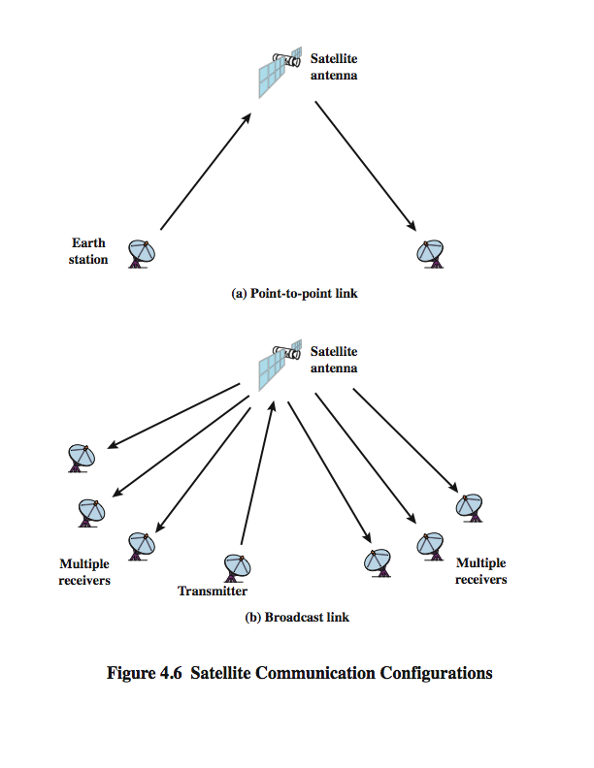
Satellite Point to Point Link
Notes:
Stallings DCC8e Figure 4.6 depicts in a general way two common configurations for satellite communication. In the first, the satellite is being used to provide a point-to-point link between two distant ground-based antennas.

Slide 31
Satellite Broadcast Link
Notes:
Stallings DCC8e Figure 4.6 depicts in a general way two common configurations for satellite communication. In the second, the satellite provides communications between one ground-based transmitter and a number of ground-based receivers.

Slide 33
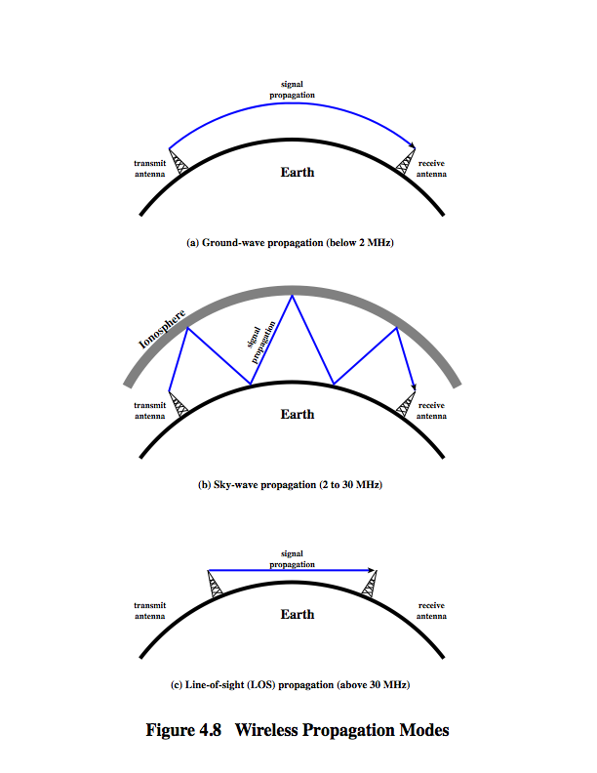
Wireless Propagation Ground Wave
Notes:
A signal radiated from an antenna travels along one of three routes: ground wave, sky wave, or line of sight (LOS), as shown in Stallings DCC8e Figure 4.8.
Ground wave propagation more or less follows the contour of the earth and can propagate considerable distances, well over the visual horizon. This effect is found in frequencies up to about 2 MHz. Several factors account for the tendency of electromagnetic wave in this frequency band to follow the earth's curvature. One factor is that the electromagnetic wave induces a current in the earth's surface, the result of which is to slow the wavefront near the earth, causing the wavefront to tilt downward and hence follow the earth's curvature. Another factor is diffraction, which is a phenomenon having to do with the behavior of electromagnetic waves in the presence of obstacles. Electromagnetic waves in this frequency range are scattered by the atmosphere in such a way that they do not penetrate the upper atmosphere. The best-known example of ground wave communication is AM radio.

Slide 34
Wireless Propagation Sky Wave
Notes:
Sky wave propagation is used for amateur radio, CB radio, and international broadcasts such as BBC and Voice of America. With sky wave propagation, a signal from an earth-based antenna is reflected from the ionized layer of the upper atmosphere (ionosphere) back down to earth. Although it appears the wave is reflected from the ionosphere as if the ionosphere were a hard reflecting surface, the effect is in fact caused by refraction. Refraction is described subsequently. A sky wave signal can travel through a number of hops, bouncing back and forth between the ionosphere and the earth's surface, as shown in Stallings DCC8e Figure 4.8b. With this propagation mode, a signal can be picked up thousands of kilometers from the transmitter.

Slide 35
Wireless Propagation Line of Sight
Notes:
Above 30 MHz, neither ground wave nor sky wave propagation modes operate, and communication must be by line of sight (Stallings DCC8e Figure 4.8c). For satellite communication, a signal above 30 MHz is not reflected by the ionosphere and therefore a signal can be transmitted between an earth station and a satellite overhead that is not beyond the horizon. For ground-based communication, the transmitting and receiving antennas must be within an effective line of sight of each other. The term effective is used because microwaves are bent or refracted by the atmosphere. The amount and even the direction of the bend depends on conditions, but generally microwaves are bent with the curvature of the earth and will therefore propagate farther than the optical line of sight. In this book, we are almost exclusively concerned with LOS communications.

Slide 36
Broadcast Radio
radio is 3kHz to 300GHz
use broadcast radio, 30MHz - 1GHz, for FM radio.
is omnidirectional
still need line of sight
suffers from multipath interference
reflections from land, water, other objects
Notes:
Radio is a general term used to encompass frequencies in the range of 3 kHz to 300 GHz. We are using the informal term broadcast radio to cover the VHF and part of the UHF band: 30 MHz to 1 GHz. This range covers FM radio and UHF and VHF television. This range is also used for a number of data networking applications. The principal difference between broadcast radio and microwave is that the former is omnidirectional and the latter is directional. Thus broadcast radio does not require dish-shaped antennas, and the antennas need not be rigidly mounted to a precise alignment.
The range 30 MHz to 1 GHz is an effective one for broadcast communications. Unlike the case for lower-frequency electromagnetic waves, the ionosphere is transparent to radio waves above 30 MHz. Thus transmission is limited to the line of sight, and distant transmitters will not interfere with each other due to reflection from the atmosphere. Unlike the higher frequencies of the microwave region, broadcast radio waves are less sensitive to attenuation from rainfall. A prime source of impairment for broadcast radio waves is multipath interference. Reflection from land, water, and natural or human-made objects can create multiple paths between antennas, eg ghosting on TV pictures.

Slide 37
Infrared
modulate noncoherent infrared light
line of sight (or reflection)
are blocked by walls
no licenses required
typical uses
TV remote control
Notes:
Infrared communications is achieved using transmitters/receivers (transceivers) that modulate noncoherent infrared light. Transceivers must be within the line of sight of each other either directly or via reflection from a light-colored surface such as the ceiling of a room.
One important difference between infrared and microwave transmission is that the former does not penetrate walls. Thus the security and interference problems encountered in microwave systems are not present. Furthermore, there is no frequency allocation issue with infrared, because no licensing is required.

Slide 38
Refraction
velocity of electromagnetic wave is a function of density of material
~3 x 10⁸ m/s in vacuum, less in anything else
speed changes as move between media
Index of refraction (refractive index)
varies with wavelength
have gradual bending if medium density varies
density of atmosphere decreases with height
results in bending towards earth
Notes:
Before proceeding, a brief discussion of refraction is warranted. Refraction occurs because the velocity of an electromagnetic wave is a function of the density of the medium through which it travels. In a vacuum, an electromagnetic wave (such as light or a radio wave) travels at approximately 3 × 10⁸ m/s, the constant c. In air, water, glass, and other transparent or partially transparent media, electromagnetic waves travel at speeds less than c.
When an electromagnetic wave moves from a medium of one density to a medium of another density, its speed changes. The effect is to cause a one-time bending of the direction of the wave at the boundary between the two media.
The index of refraction, or refractive index, of one medium relative to another is the sine of the angle of incidence divided by the sine of the angle of refraction. The index of refraction is also equal to the ratio of the respective velocities in the two media. The absolute index of refraction of a medium is calculated in comparison with that of a vacuum. Refractive index varies with wavelength, so that refractive effects differ for signals with different wavelengths.
Although an abrupt, one-time change in direction occurs as a signal moves from one medium to another, a continuous, gradual bending of a signal will occur if it is moving through a medium in which the index of refraction gradually changes. Under normal propagation conditions, the refractive index of the atmosphere decreases with height so that radio waves travel more slowly near the ground than at higher altitudes. The result is a slight bending of the radio waves toward the earth, which causes a difference between the optical and radio horizons fpr LOS transmissions.

Slide 39
Line of Sight Transmission
Free space loss
loss of signal with distance
Atmospheric Absorption
from water vapour and oxygen absorption
Multipath
multiple interfering signals from reflections
Refraction
bending signal away from receiver
Notes:
Stallings DCC8e section 3.3 discussed various transmission impairments common to both guided and wireless transmission. In this section, we extend the discussion to examine some impairments specific to wireless line-of-sight transmission.
For any type of wireless communication the signal disperses with distance. Therefore, an antenna with a fixed area will receive less signal power the farther it is from the transmitting antenna. For satellite communication this is the primary mode of signal loss. Even if no other sources of attenuation or impairment are assumed, a transmitted signal attenuates over distance because the signal is being spread over a larger and larger area. This form of attenuation is known as free space loss.
An additional loss between the transmitting and receiving antennas is atmospheric absorption. Water vapor and oxygen contribute most to attenuation. A peak attenuation occurs in the vicinity of 22 GHz due to water vapor. At frequencies below 15 GHz, the attenuation is less. The presence of oxygen results in an absorption peak in the vicinity of 60 GHz but contributes less at frequencies below 30 GHz. Rain and fog (suspended water droplets) cause scattering of radio waves that results in attenuation.
For some wireless systems, there are obstacles in abundance. The signal can be reflected by such obstacles so that multiple copies of the signal with varying delays can be received, resulting in multipath interference. Depending on the differences in the path lengths of the direct and reflected waves, the composite signal can be either larger or smaller than the direct signal.
Radio waves are refracted (or bent) when they propagate through the atmosphere. Normally, the speed of the signal increases with altitude, causing radio waves to bend downward. However, on occasion, weather conditions may lead to variations in speed with height that differ significantly from the typical variations. This may result in a situation in which only a fraction or no part of the line-of-sight wave reaches the receiving antenna.

Slide 40

free space loss is
4.2

Slide 41
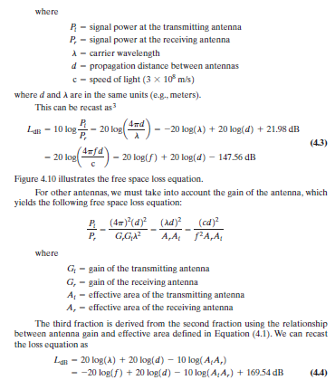

Slide 42
1 Example
Show that doubling the transmission frequency or doubling the distance between transmitting antenna and receiving antenna attenuates the power received by 6 dB.

Slide 43
From Equation 4.2, the ratio of transmitted power to received power is
Pt/Pr = (4πd/λ)²
If we double the frequency, we halve λ, or if we double the distance, we double d,
so the new ratio for either of these events is:
Pt/Pr₂ = (8πd/λ)²
Therefore:
10 log (Pr/Pr₂) = 10 log (2²) = 6 dB

Slide 44
2 Example
The audio power of the human voice is concentrated at about 300 Hz. Antennas of the appropriate size for this frequency are impracticably large, so that to send voice by radio the voice signal must be used to modulate a higher (carrier) frequency for which the natural antenna size is smaller.
a. What is the length of an antenna half the wavelength long for sending radio at 300 Hz?
b. An alternative is to use a modulation scheme, for transmitting the voice signal by modulating a carrier frequency, so that the bandwidth of the signal is a narrow band centered on the carrier frequency. Suppose we would like a half-wave antenna to have a length of 1 meter. What carrier frequency would we use?

Slide 45
a. Using λf = c, we have λ = (3 × 10⁸ m/sec)/(300 Hz) = 1,000 km, so that
λ/2 = 500 km.
b. The carrier frequency corresponding to
λ/2 = 1 m is given by:
f = c/λ = (3 × 10⁸ m/sec)/(2 m) = 150 MHz.

Slide 46
3 Example
You are communicating between two satellites. The transmission obeys the free space law. The signal is too weak. Your vendor offers you two options. The vendor can use a higher frequency that is twice the current frequency or can double the effective area of both of the antennas. Which will offer you more received power or will both offer the same improvement, all other factors remaining equal? How much improvement in the received power do you obtain from the best option?

Slide 47

The received signal is, essentially, the same
The received power will increase by a factor of 4

Slide 48
4 Example
Suppose a transmitter produces 50 W of power.
a. Express the transmit power in units of dBm and dBW.
b. If the transmitter’s power is applied to a unity gain antenna with a 900-MHz carrier frequency, what is the received power in dBm at a free space distance of 100 m?
c. Repeat (b) for a distance of 10 km.
d. Repeat (c) but assume a receiver antenna gain of 2.

Slide 49
a
PowerdBW = 10 log (PowerW) = 10 log (50) = 17 dBW
PowerdBm = 10 log (PowermW) = 10 log (50,000) = 47 dBm

Slide 50

b
L_{dB} = 20 log(900 × 10⁶) +20 log (100) – 147.56 = 120 + 59.08 +40 – 147.56 = 71.52
Therefore, received power in dBm = 47 – 71.52 = –24.52 dBm

Slide 51
c
L_{dB} = 120 + 59.08 +80 – 147.56 =111.52;
P_{r,dBm} = 47 – 111.52 = –64.52 dBm

Slide 52
d
The antenna gain results in an increase of 3 dB, so that P_{r,dBm} = –61.52 dBm

Slide 53

5 Example
A microwave transmitter has an output of 0.1 W at 2 GHz. Assume that this transmitter is used in a microwave communication system where the transmitting and receiving antennas are parabolas, each 1.2 m in diameter.
a. What is the gain of each antenna in decibels?
b. Taking into account antenna gain, what is the effective radiated power of the transmitted signal?
c. If the receiving antenna is located 24 km from the transmitting antenna over a free space path, find the available signal power out of the receiving antenna in dBm units.

Slide 54
a
G = 7A/λ² = 7Af²/c²
= (7 × π × (0.6)² × (2×10⁹)²]/(3 × 10⁸)²
= 351.85
G_{dB} = 25.46 dB(transmitting and receiving antennas )

Slide 55
b
0.1 W x 351.85 = 35.185 W

Slide 56
c
Use LdB = 20 log (4π) + 20 log (d) + 20 log (f) – 20 log (c) – 10 log(Gr) – 10 log (Gt)
LdB = 21.98 + 87.6 + 186.02 – 169.54 – 25.46 – 25.46 = 75.14 dB
The transmitter power, in dBm is
10 log (100) = 20.(0.1W)
The available received signal power is
20 – 75.14 = –55.14 dBm

Slide 57
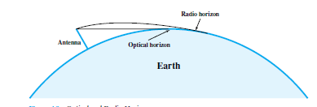

Slide 58


Slide 59
6 Example
Determine the height of an antenna for a TV station that must be able to reach customers up to 80 km away.

Slide 60
For radio line of sight, we use d = 3.57( Kh )^{1/2}, with K = 4/3, we have
80² = (3.57)² × 1.33 × h.
Solving for h, we get h = 378 m.

